Slide 1

NETWORKING BASICS 2

Slide 2
SWITCHING

Slide 3
Layer 2 basics
Builds and maintains a MAC address table used for forwarding packets
Switch stores the source mac address and the port number that it receives a packet

Slide 4
ARP
Address Resolution Protocol helps to determine the MAC address of the destination host before forwarding
Computers and Routers maintains an ARP table
Uses broadcast to learn the destination mac address

Slide 5
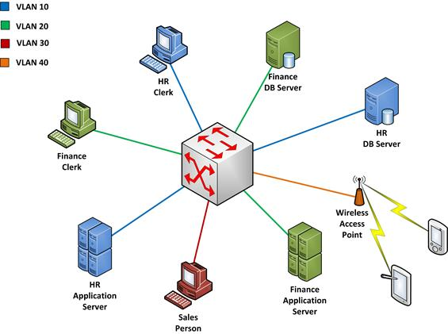
VLAN Foundations
Logically groups users
Segments broadcast domains
Subnet correlation
Access control
Quality of Service

Slide 6
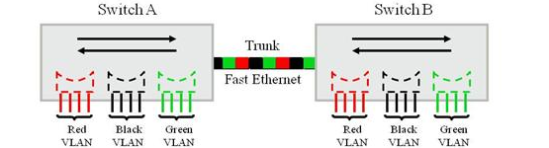
Trunk Links
VLANs can span across multiple switches with a help of Trunk links
Places a unique identifier in header of each frame
Functions at Layer 2
Each logical VLAN is like a separate switch
Trunking protocols: ISL and 802.1q

Slide 7
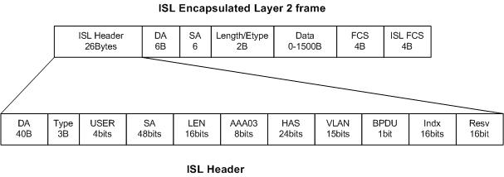
ISL Encapsulation
Cisco proprietary

Slide 8
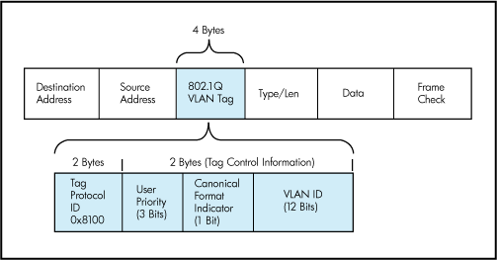
802.1q Tagging
Industry standard

Slide 9
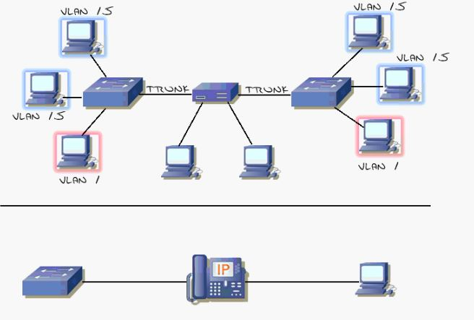
Native VLAN

Slide 10
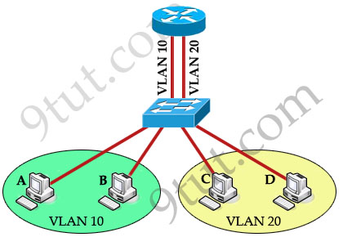
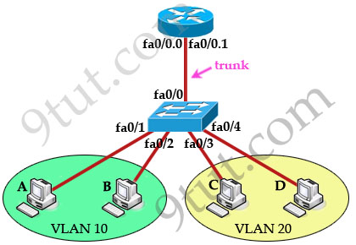
Inter VLAN Routing
Router on a stick
Subinterfaces (logical) are created for the physical interface
802.1q tagging is configured

Slide 11
ROUTING

Slide 12
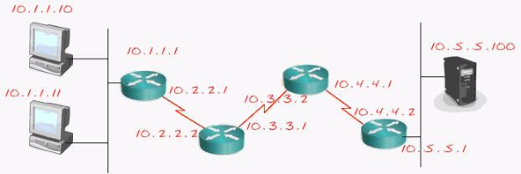
How routing works?
To reach anything that is outside the local network
Routers maintains a routing table
A route entry typically contains destination network, subnet mask, next hop address, administrative distance, metric

Slide 13
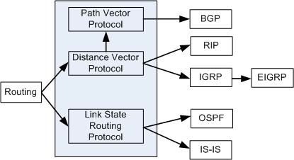
Types of Routing Protocols
Static routing
Dynamic routing
Dynamic Routing

Slide 14
Static Routing
Routes are configured manually
Route entry always stays on the routing table regardless of the state of the destination network

Slide 15
RIP version 1
Advertises only classfull networks like 10.0.0.0/8, 150.16.0.0/16, 195.20.32.0/24
Subnet mask is not included in the routing update
No authentication
Uses broadcast address to advertise networks
Determines shortest path based on hop-counts (metric)
Update timer: Routing updates sent every 30s
Invalid timer: Route is marked as invalid (hop-count=16) when no update is heard in 180s
Flush timer: Time between route is invalidated and removal of entry from the routing table which is 60s Hold-down timer: 180s, allows route to get stabilized

Slide 16
RIP version 2
Timers are same as RIPv1
Supports classless network like 10.10.1.0/24, 172.30.17.86/23, 182.73.23.0/30
Sends out subnet mask in the updates
Adds authentication
Uses multicast for updates, 224.0.0.9

Slide 17
THANK YOU

